Slide 1
Domestics and Wild animals

Slide 2
Cat is a domestic animal
I am a CAT
I am blue
I like play

Slide 3
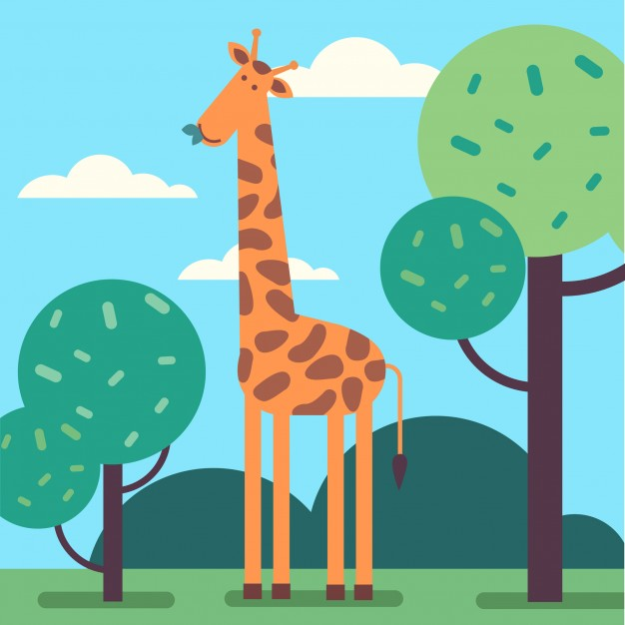
Giraffe is a wild animal
I am a GIRAFFE
I am orange
I am tall

Slide 4
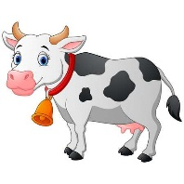
Cow is a domestic animal
I am a COW
I am White and black
I am big

Slide 5
Octopus is a wild animal
I am an OCTOPUS
I am purple
I can swim

Slide 6
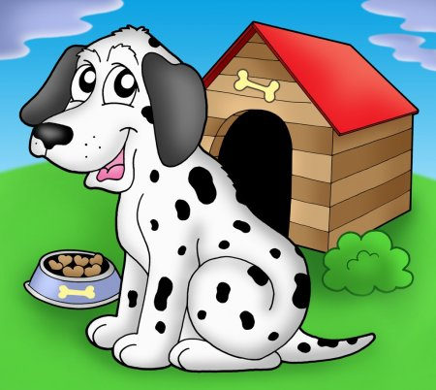
Dog is a domestic animal
I am a DOG
I am purple
I like run

Slide 7
Frog is a wild animal
I am a FROG
I am green
I like jump

Slide 8
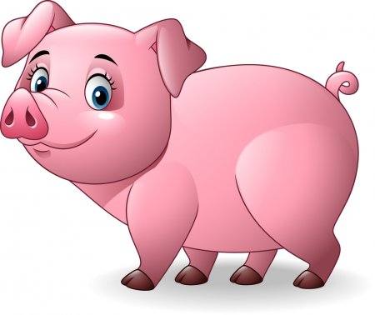
Pig is a domestic animal
I am a PIG
I am pink
I like eat

Slide 9
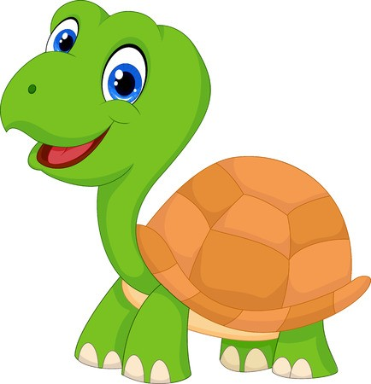
Turtle is a wild animal
I am a turtle
I am green and brown
I like jump

Slide 10
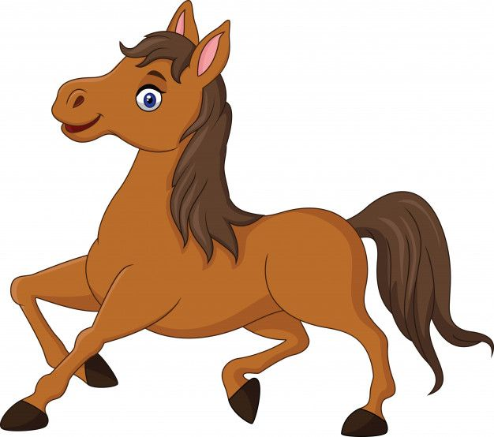
Horse is a domestic animal
I am a HORSE
I am brown
I like eat

Slide 11
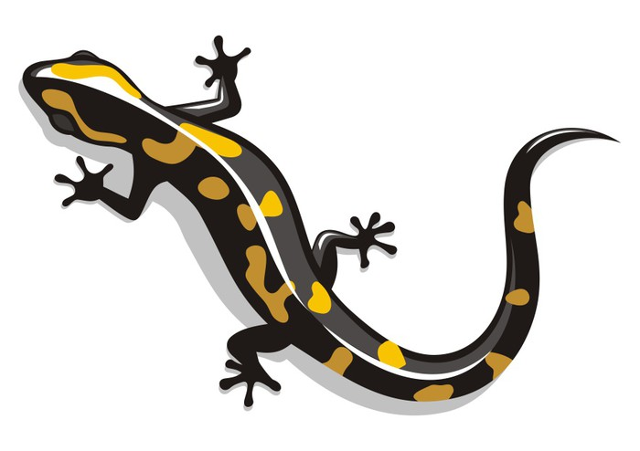
Salamander is a wild animal
I am a SALAMANDER
I am orange and black
I like jump

